Slide 1
Basic Commands in Hadoop

Slide 2
Basic Commands In Hadoop
We need to know some basic commands in hadoop in order to access the HDFS .
Only Admins can access the HDFS directly .
Admins will give access to developers to HDFS through Edge Node .
We can create directories , transfer the file from local to HDFS , can see the data in the files in HDFS using the basic commands in hadoop.
Without knowing the basic commands , we cannot process the data in HDFS.

Slide 3

Basic Commands In Hadoop
Version : This command will check the hadoop version

Slide 4
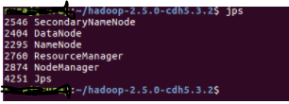
Basic Commands In Hadoop
Jps is used to check whether all the hadoop services are running or not.

Slide 5
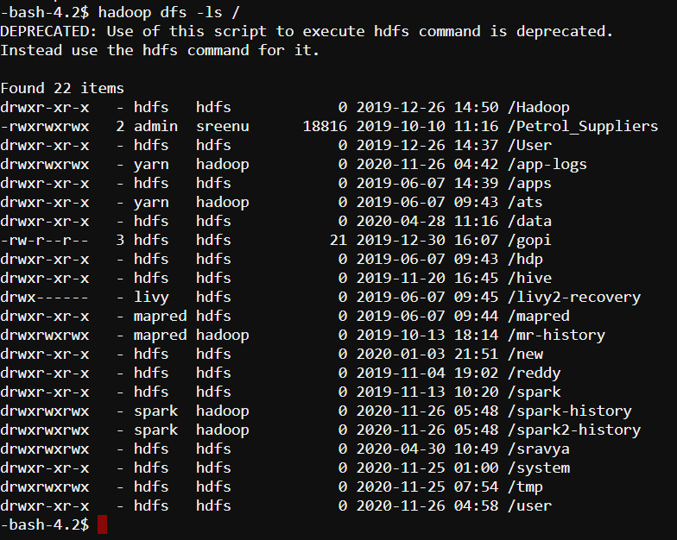
Basic Commands In Hadoop
ls: This command is used to list all the files.

Slide 6
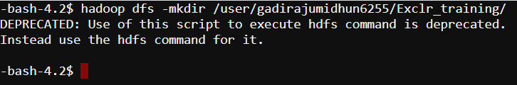
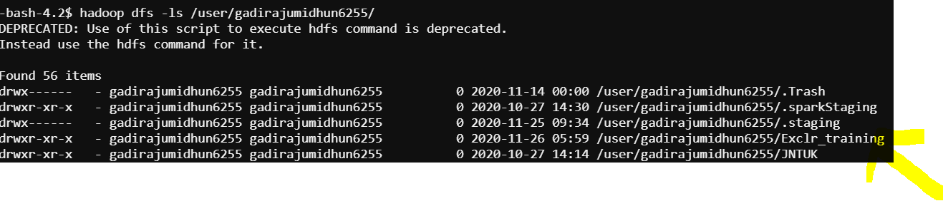
Basic Commands In Hadoop
mkdir: In order to create the new directory in HDFS , below command is used

Slide 7
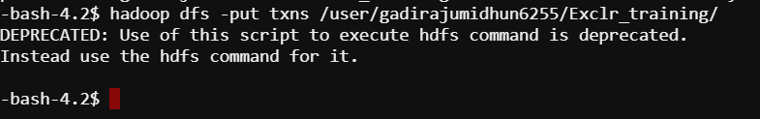
Basic Commands In Hadoop
Put : This command is used to put the data from local to HDFS
We have a file txns in local , and we are putting into HDFS .

Slide 8
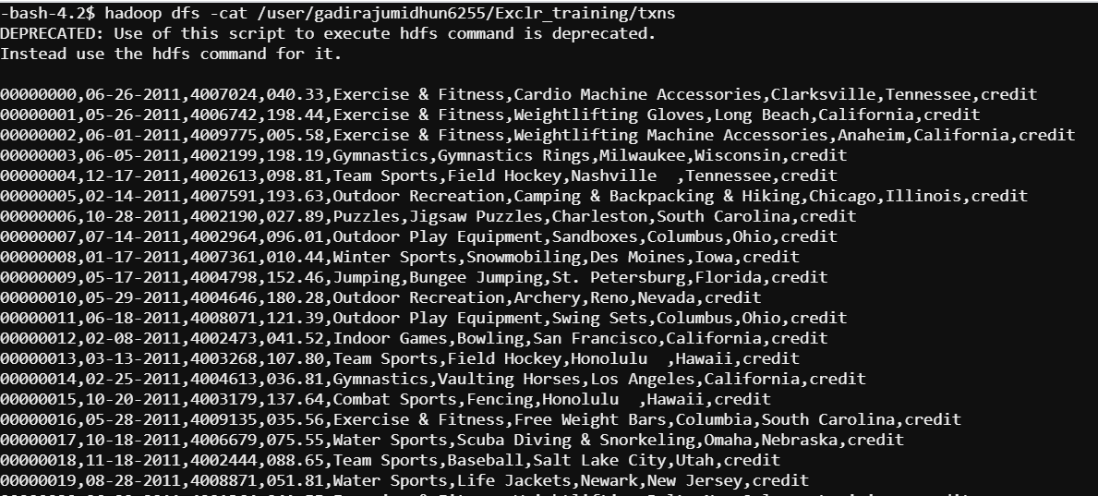
Basic Commands In Hadoop
cat: This command is used to view the data in HDFS

Slide 9
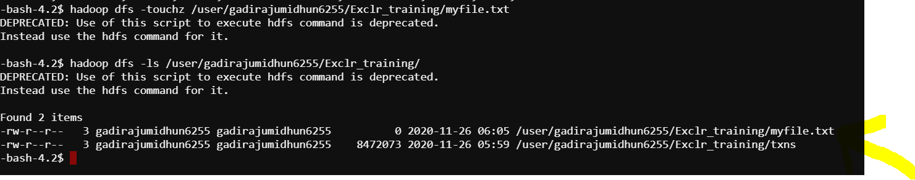
Basic Commands In Hadoop
touchz: This command will create the empty file in HDFS

Slide 10
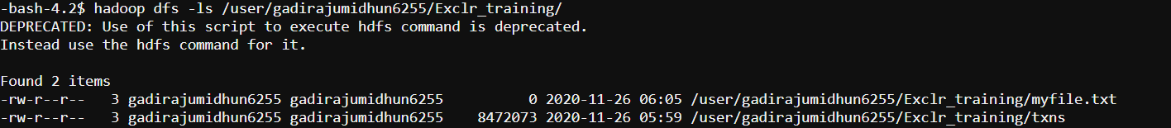
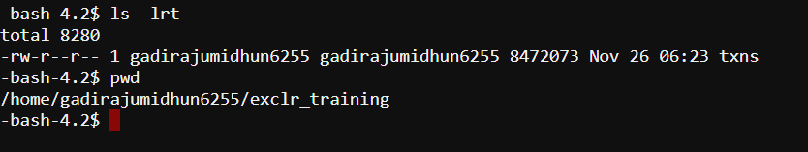
Basic Commands In Hadoop
get: This command will get the file from HDFS to Local (edge Node or Linux terminal)
We have a file txns in hdfs under the directory as shown , we will get that to local

Slide 11
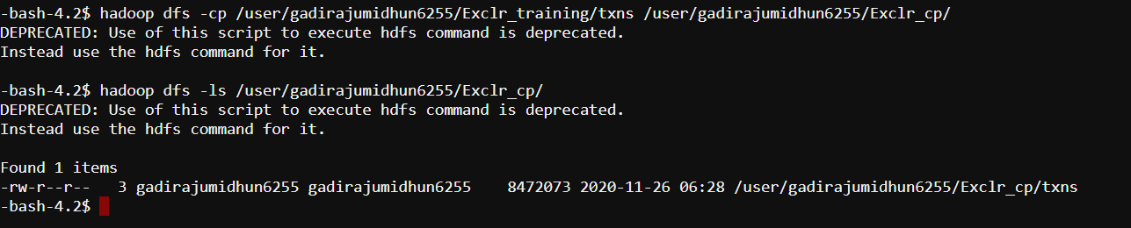
Basic Commands In Hadoop
cp: This command is used to copy the files with in HDFS directories

Slide 12
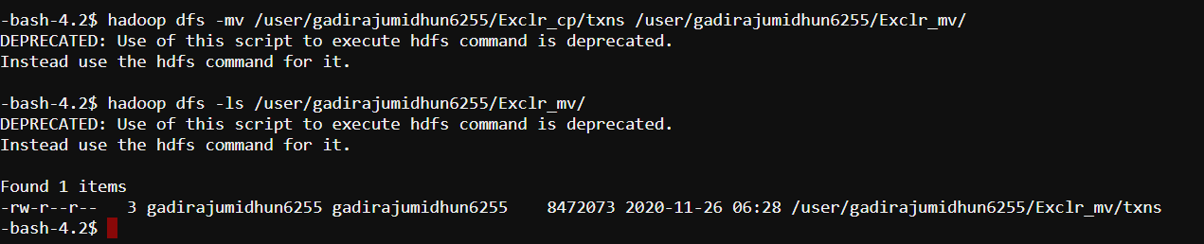
Basic Commands In Hadoop
mv: This command is used to move the files from one directory to other in HDFS ,its like cut and paste from one location in other.

Slide 13
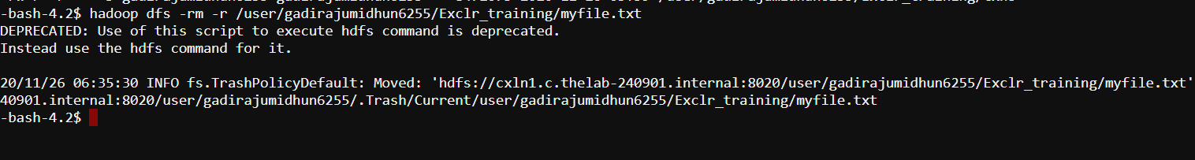
Basic Commands In Hadoop
rm -r: This command will delete a file from HDFS .

Slide 14
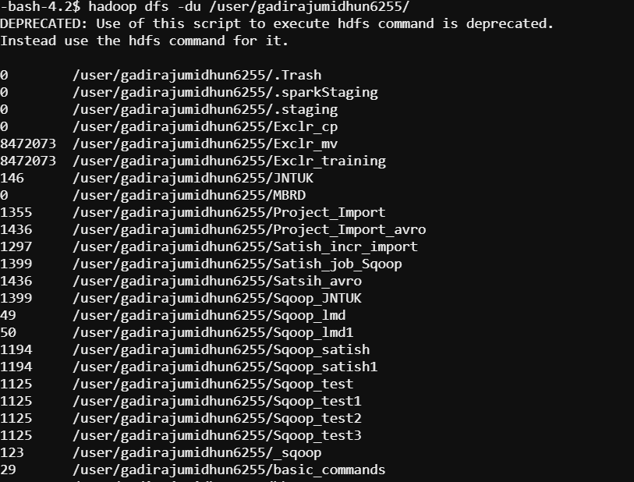
Basic Commands In Hadoop
du: This command will give the size of each file in directory

Slide 15
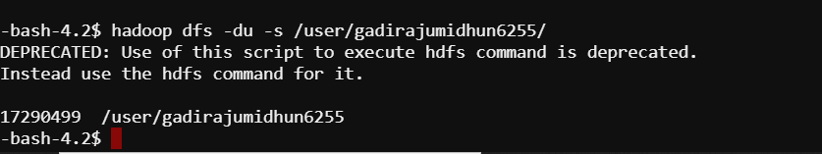
Basic Commands In Hadoop
du -s: This command will give the total size of directory

Slide 16
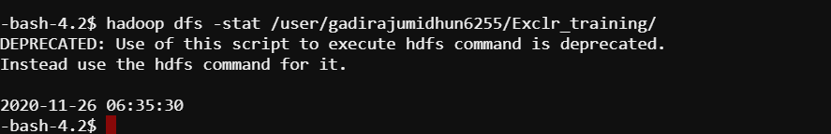
Basic Commands In Hadoop
stat: This command will give the last modified time of directory or path.

Slide 17
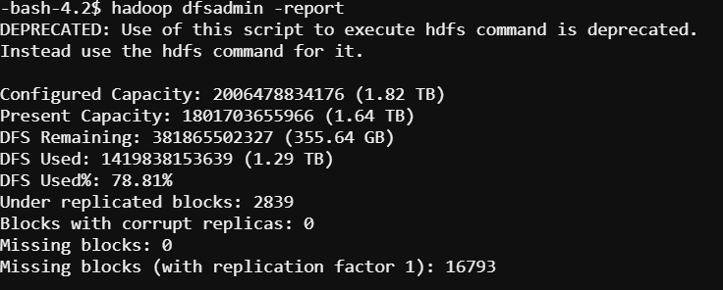
Basic Commands In Hadoop
report: This command will give the capacity of cluster

Slide 18
Thank you

